Slide 1
Smartband for Women
Designing health that women actually prioritise

Slide 2
Designed a smartband + app focused on women’s health
Goal was simple Make it easy enough to use daily
What I worked on

Slide 3
01
Women take care of everything, except their own health
02
Problem
Issues like Polycystic Ovary Syndrome are common but ignored
03
Health is often not a priority

Slide 4
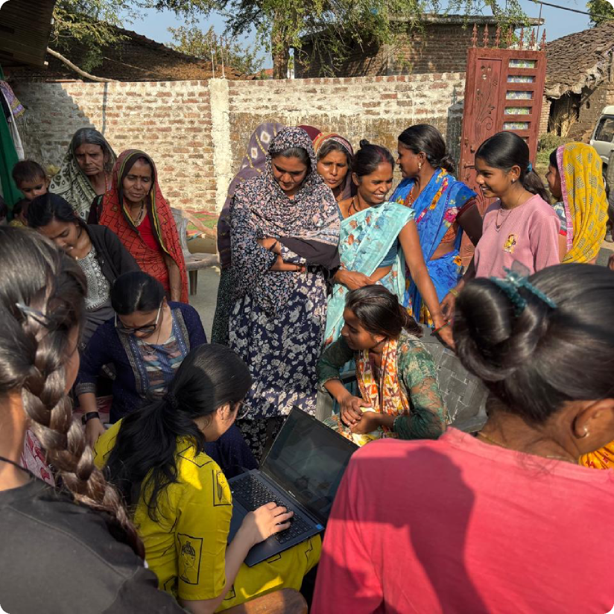
Research (ground reality)
We went to rural areas and spoke to women directly
Detailed data not shown due to NDA
PCOS and deficiencies were common
Meals were irregular
Health always came last
It wasn’t just awareness, it was behaviour

Slide 5
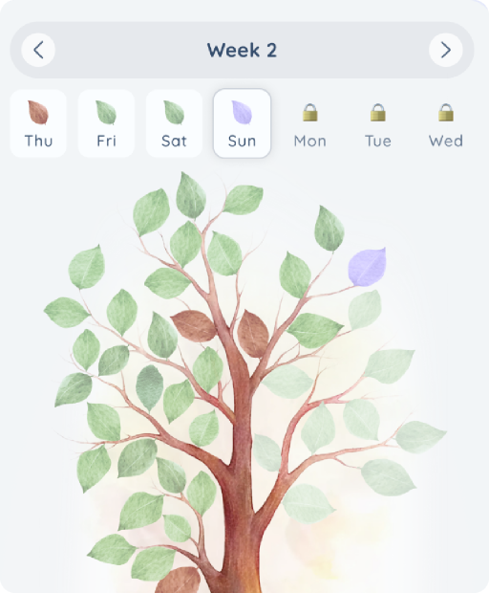
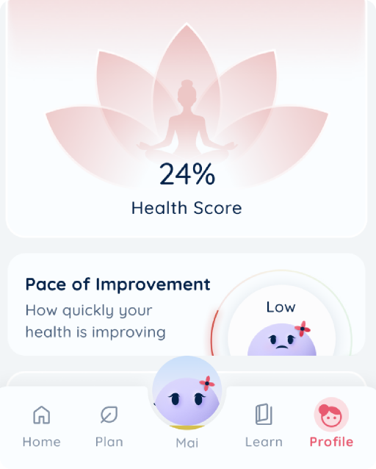
Solution approach
Personalised reversal plan
Daily health tracking

Slide 6
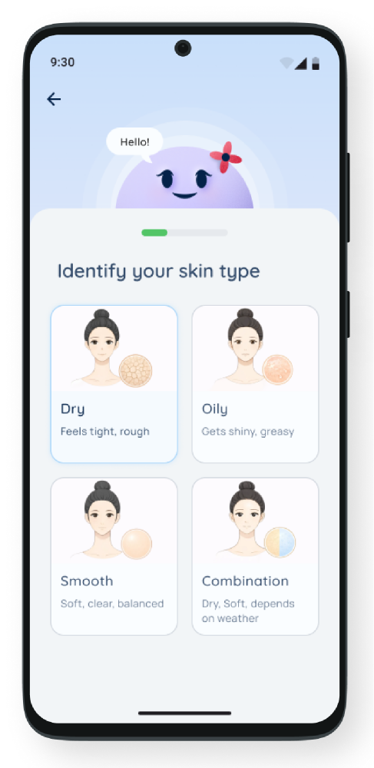
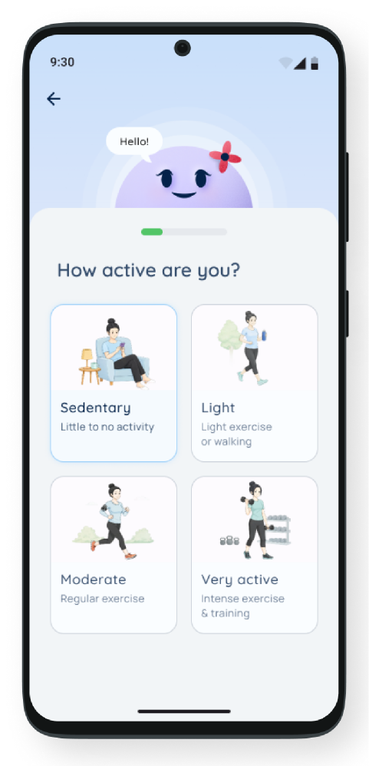
Onboarding (starting with their body)
We don’t guess, we understand first
Blood reports
Identify actual issues
Create personalised reversal plan
No generic advice, everything is specific

Slide 7
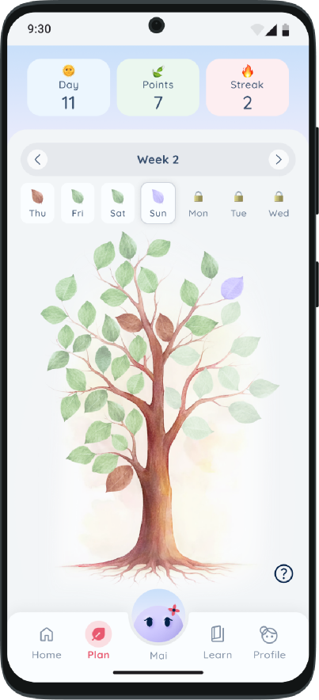
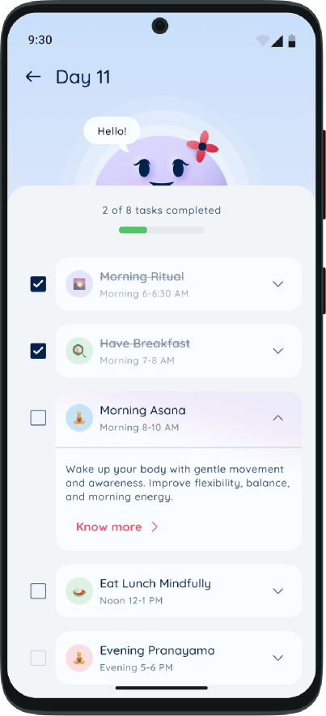
Reversal Plan (core module)
This is where change actually happens
Daily personalised tasks
Based on individual condition
Simple and easy to follow
Not overwhelming, just actionable

Slide 8
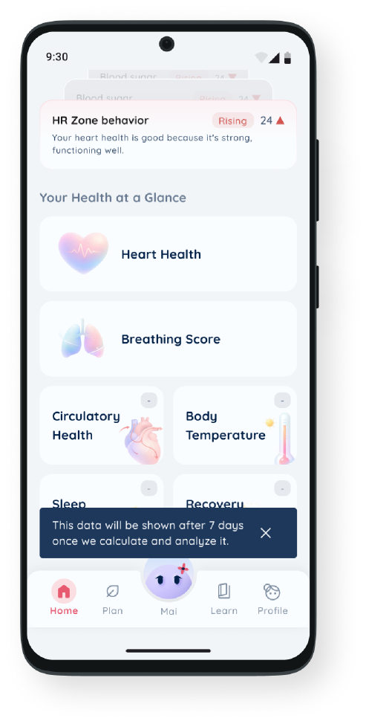
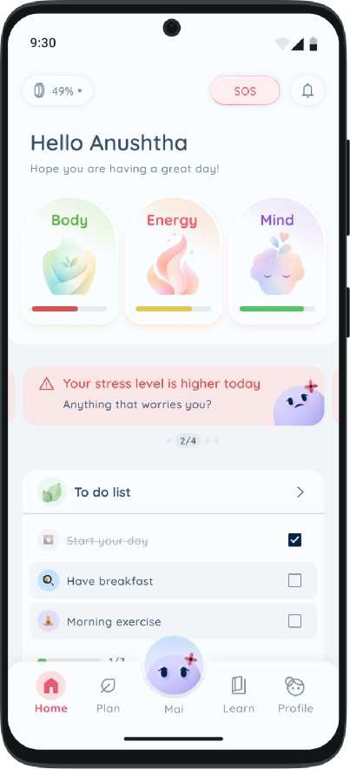
Dashboard (keeping it simple)
Health, but without confusion
Shows overall state
Just “good” or “needs attention”
No complex numbers
Users can still tap to see detailed data

Slide 9
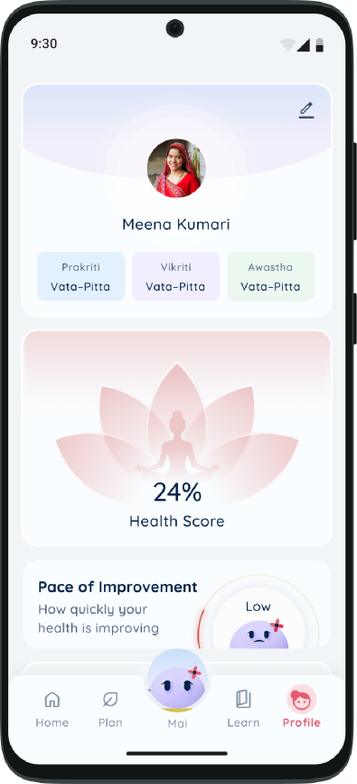
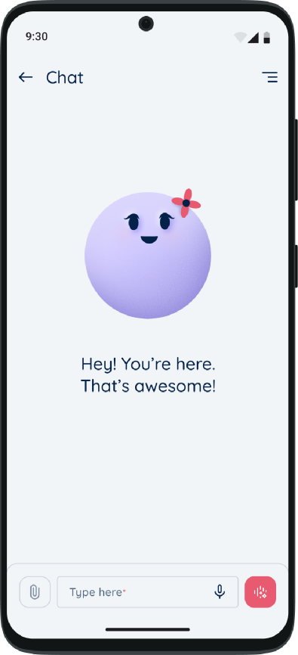
Chatbot (safe space)
Talking about health is not easy
Human-like chatbot
Safe to share concerns
Gives guidance without judgment

Slide 10
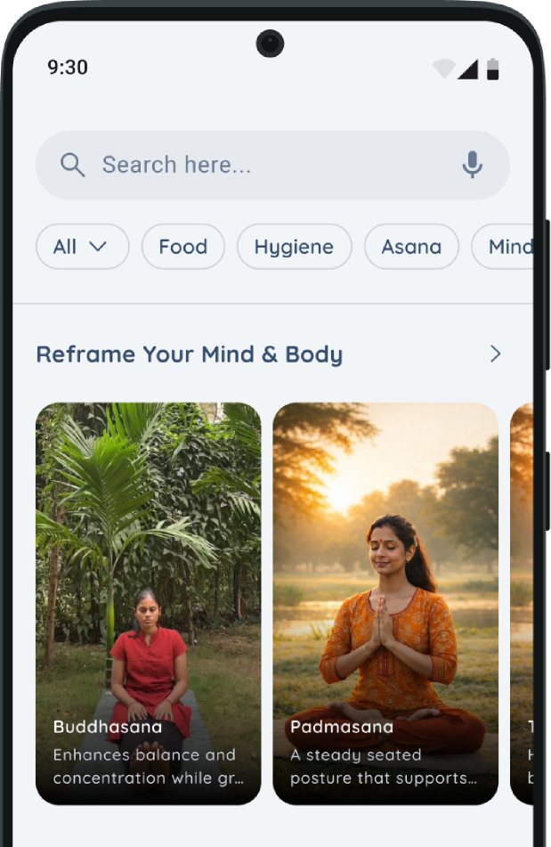
Education (building habits)
Change comes from understanding
Asana and pranayam
Healthy recipes
Lifestyle guidance
Based on Indian Vedic science
UI inspired by YouTube and Instagram

Slide 11
01
02
Not just tracking health
It slowly makes women prioritise their own health
What this actually does
03
04
Simplicity makes it usable
Behaviour change makes it valuable

Slide 12
Health doesn’t improve with data
It improves with action
This product tries to make that easier

